Slide 1
2 many engineers

Slide 2
What is it?
Charity browser add-on – making it easy to donate to charity – “shop and donate”
Summary:
If there is a better price found
donate a x% to get the saving
Select your charity of choice
Leader board
See what you have donated and people you have recommended have donated
Social
Add your friends and show your team savings

Slide 3
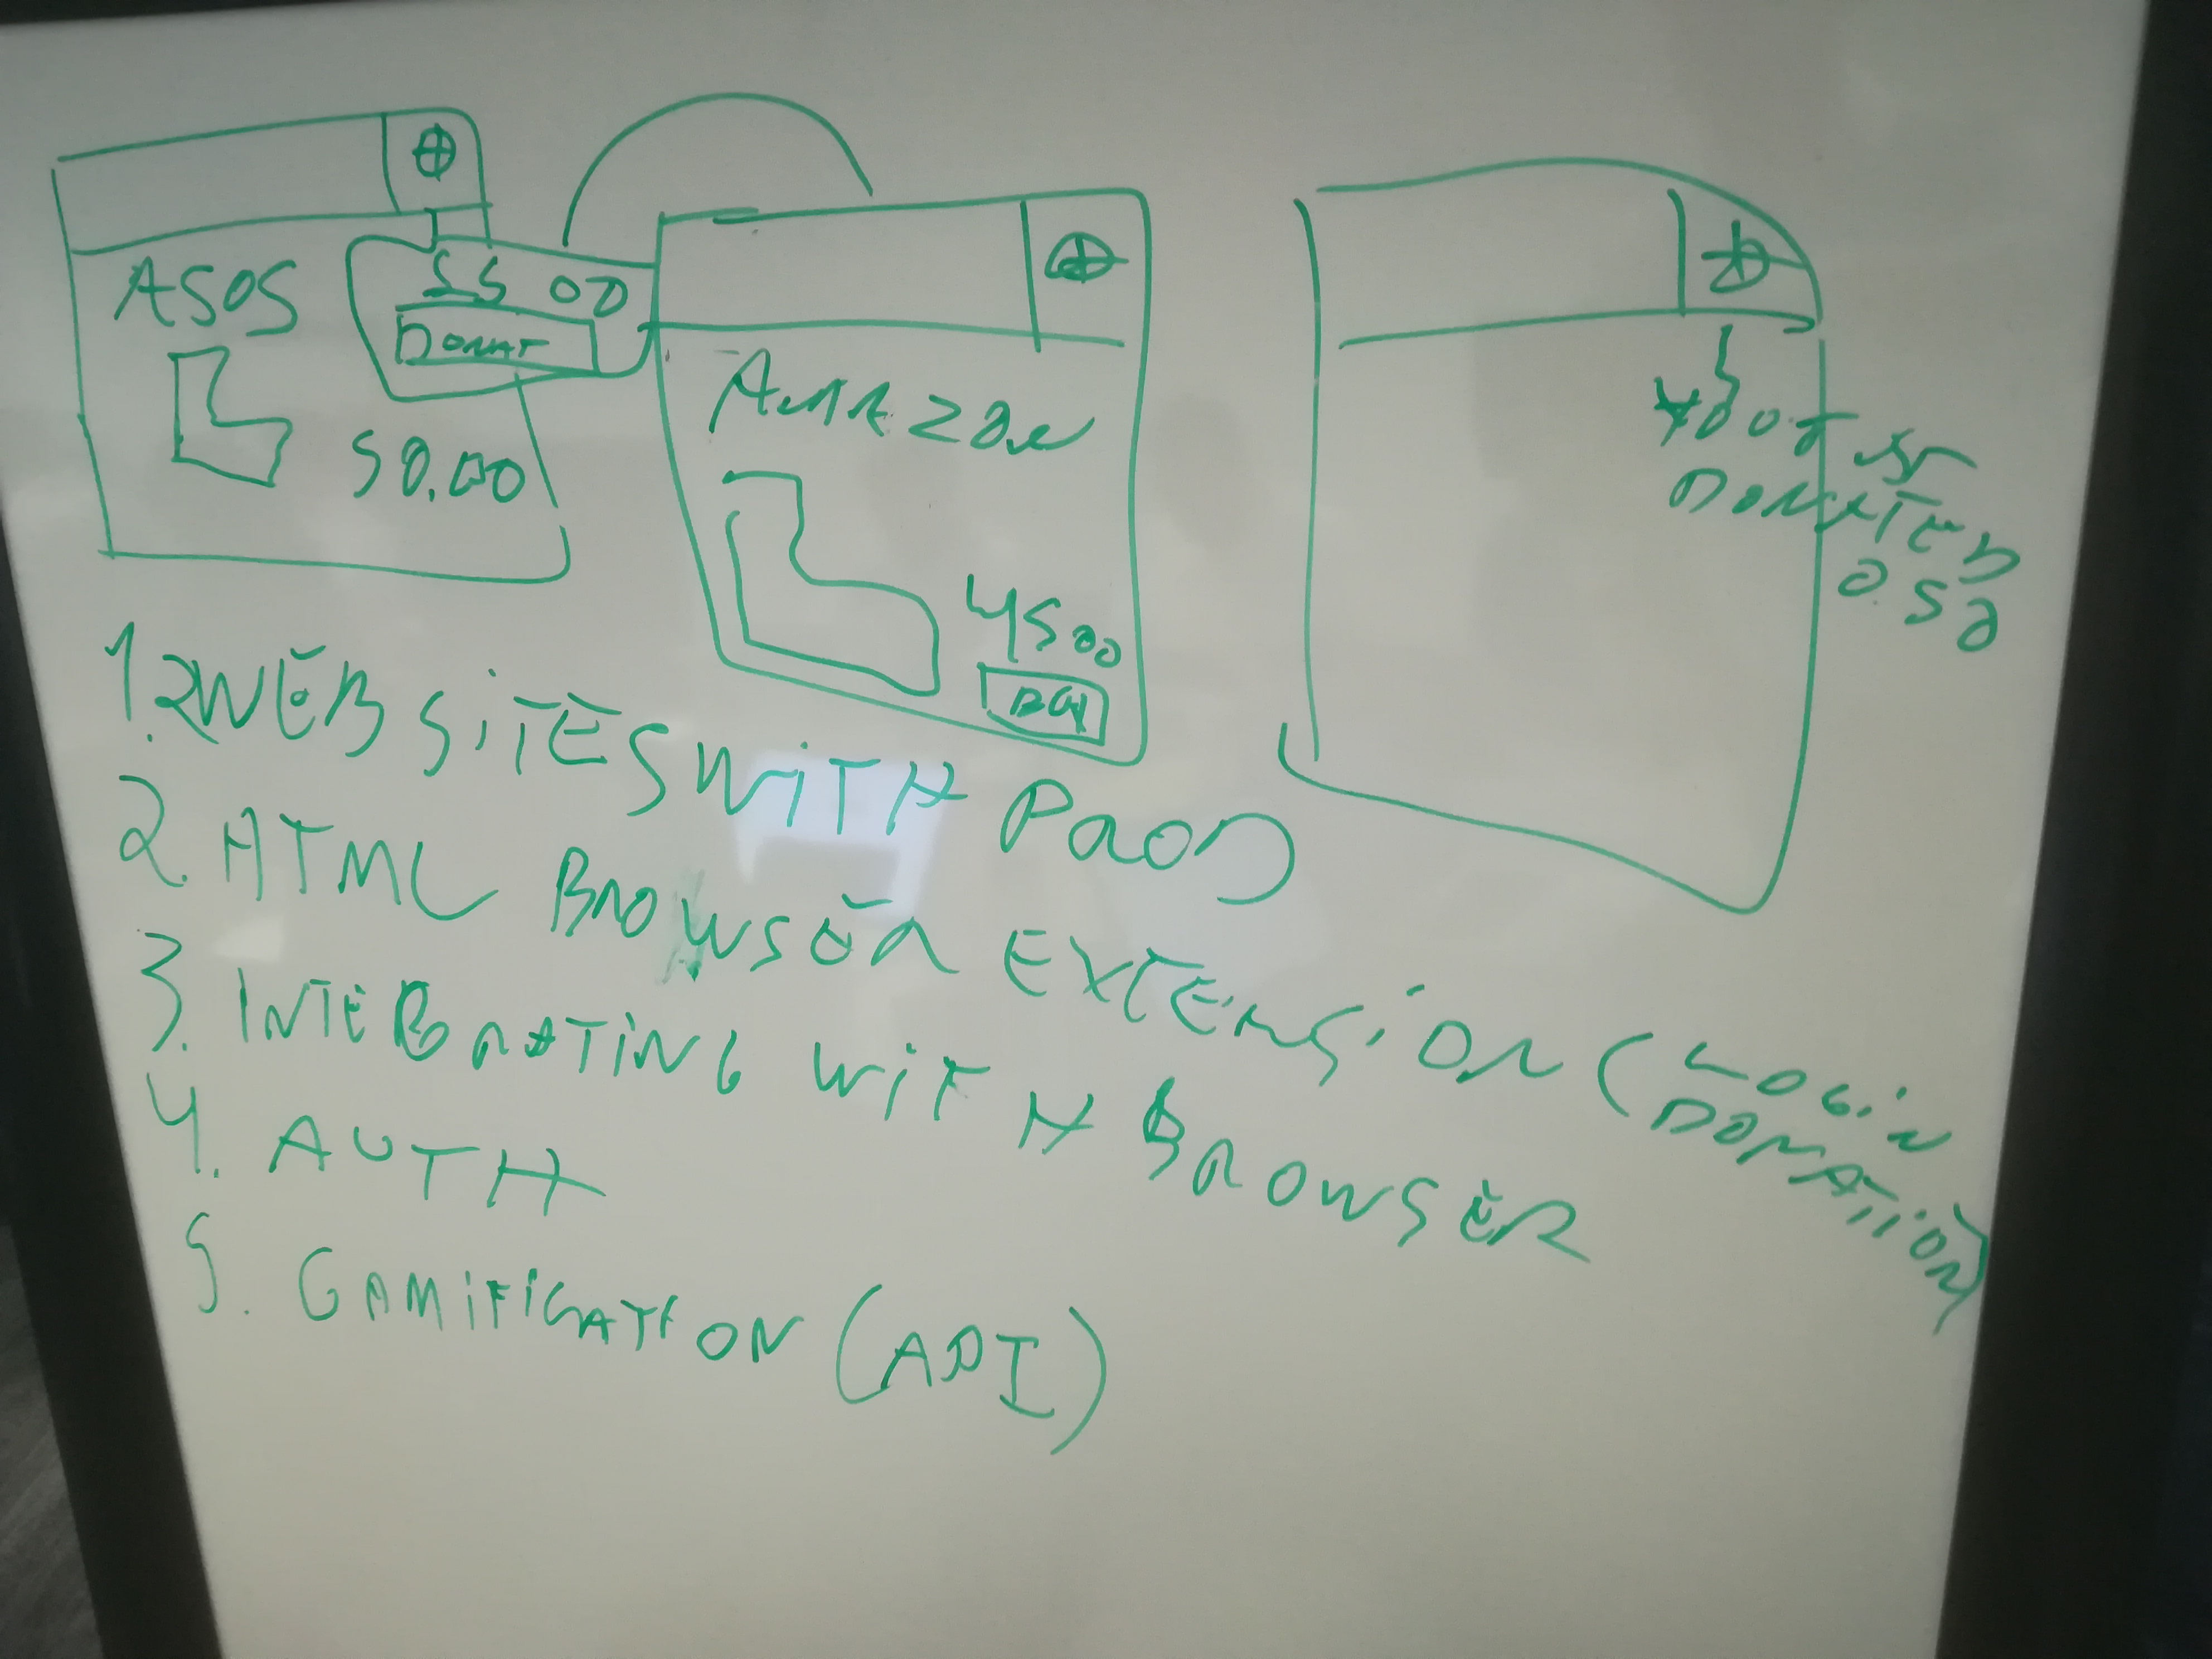
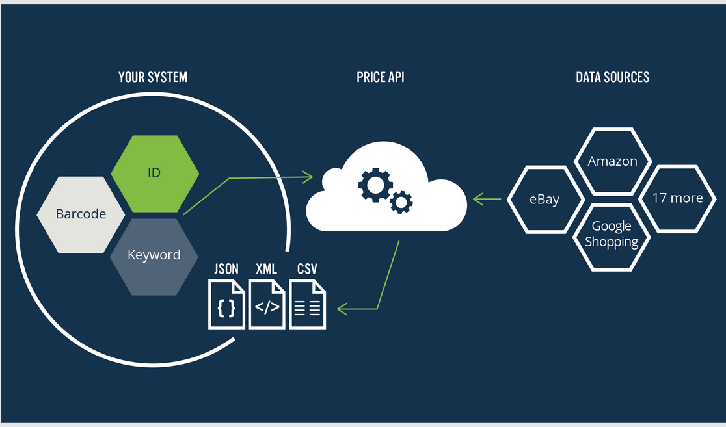
Design
We started with this

Slide 4
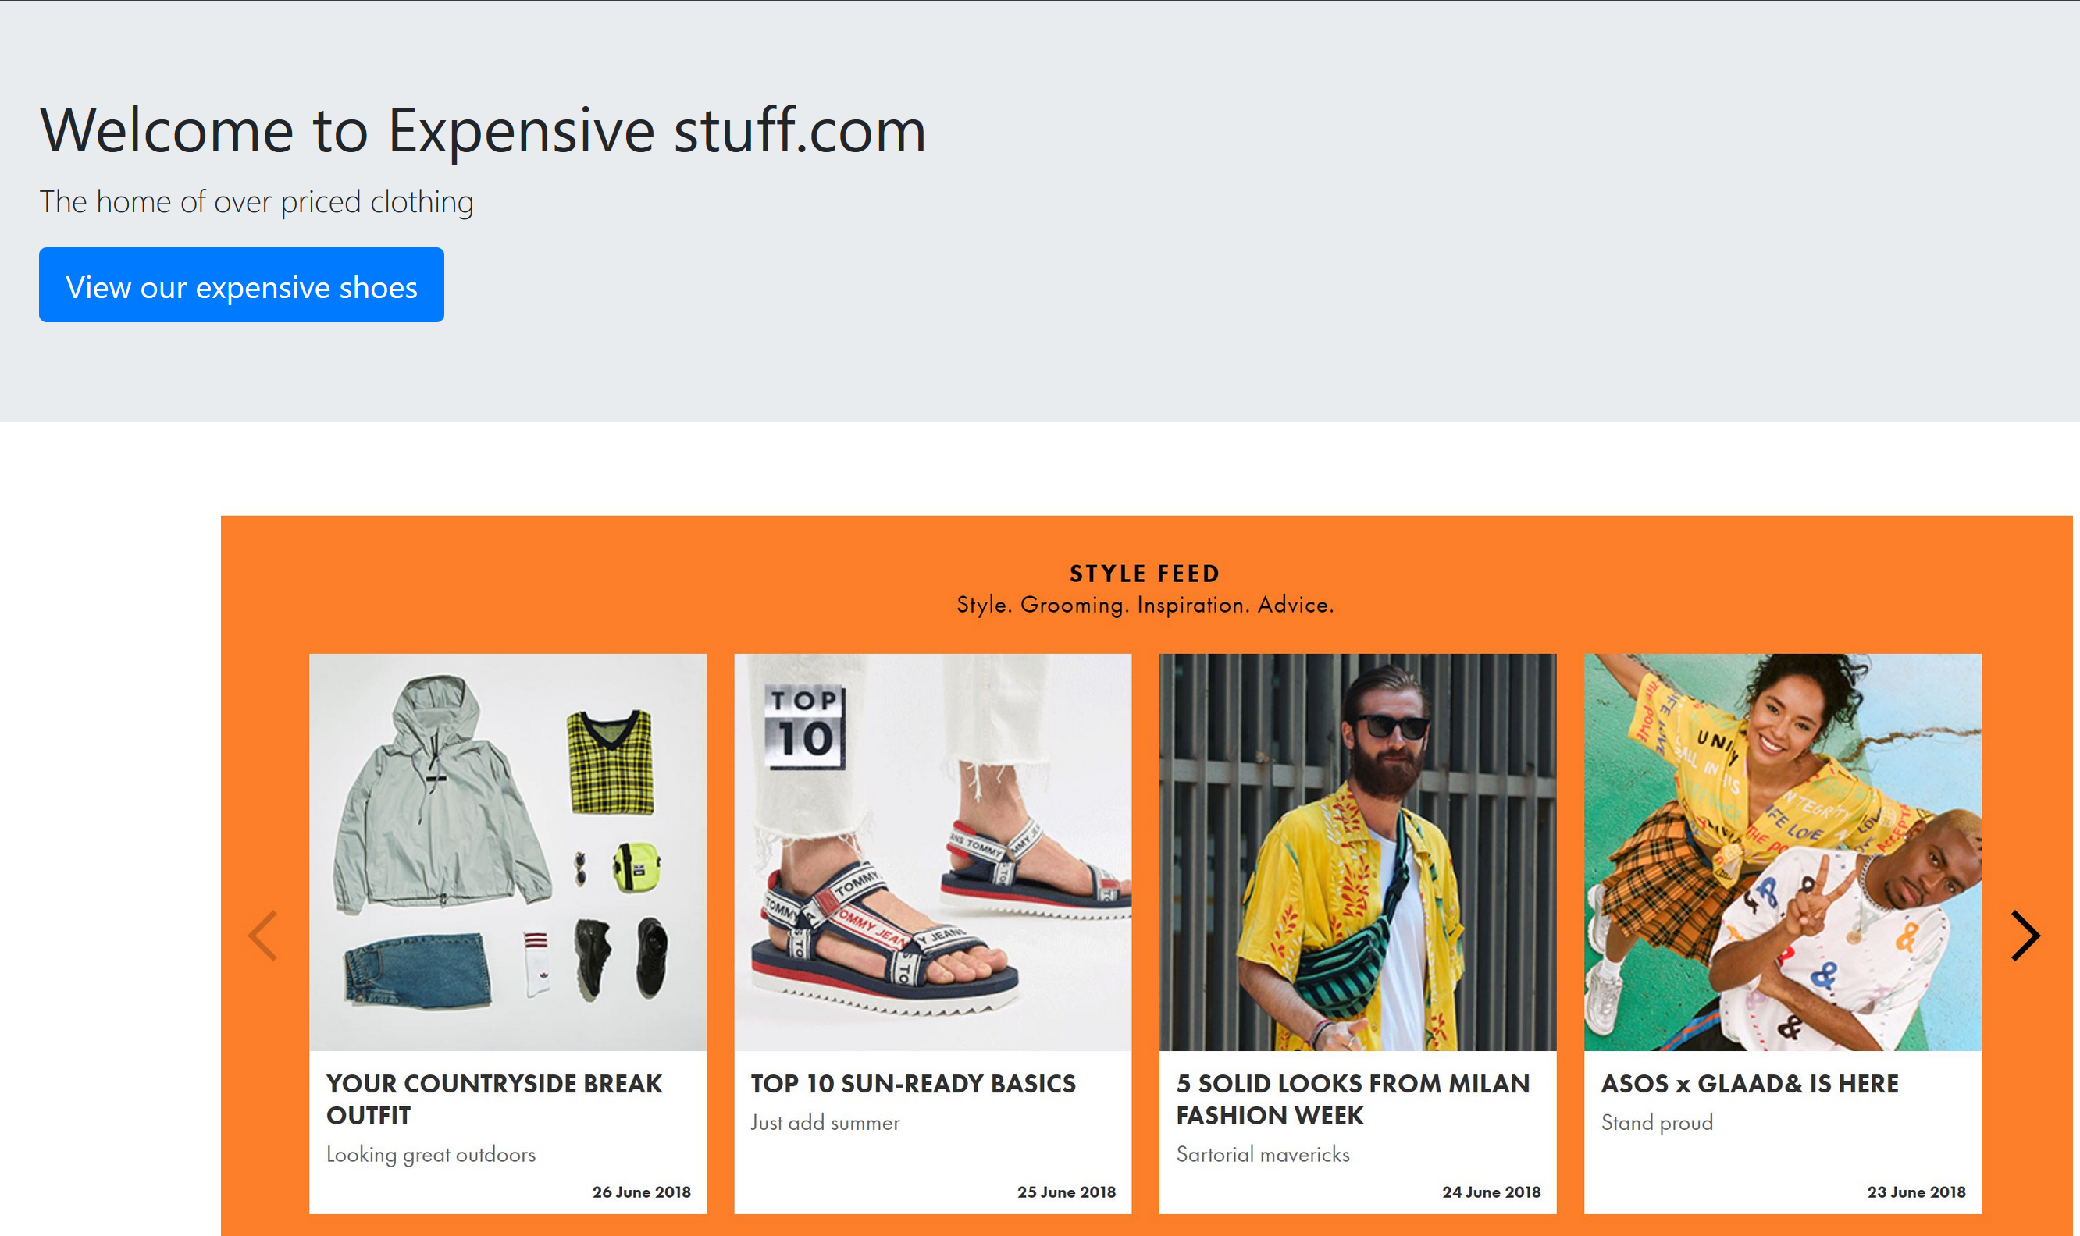
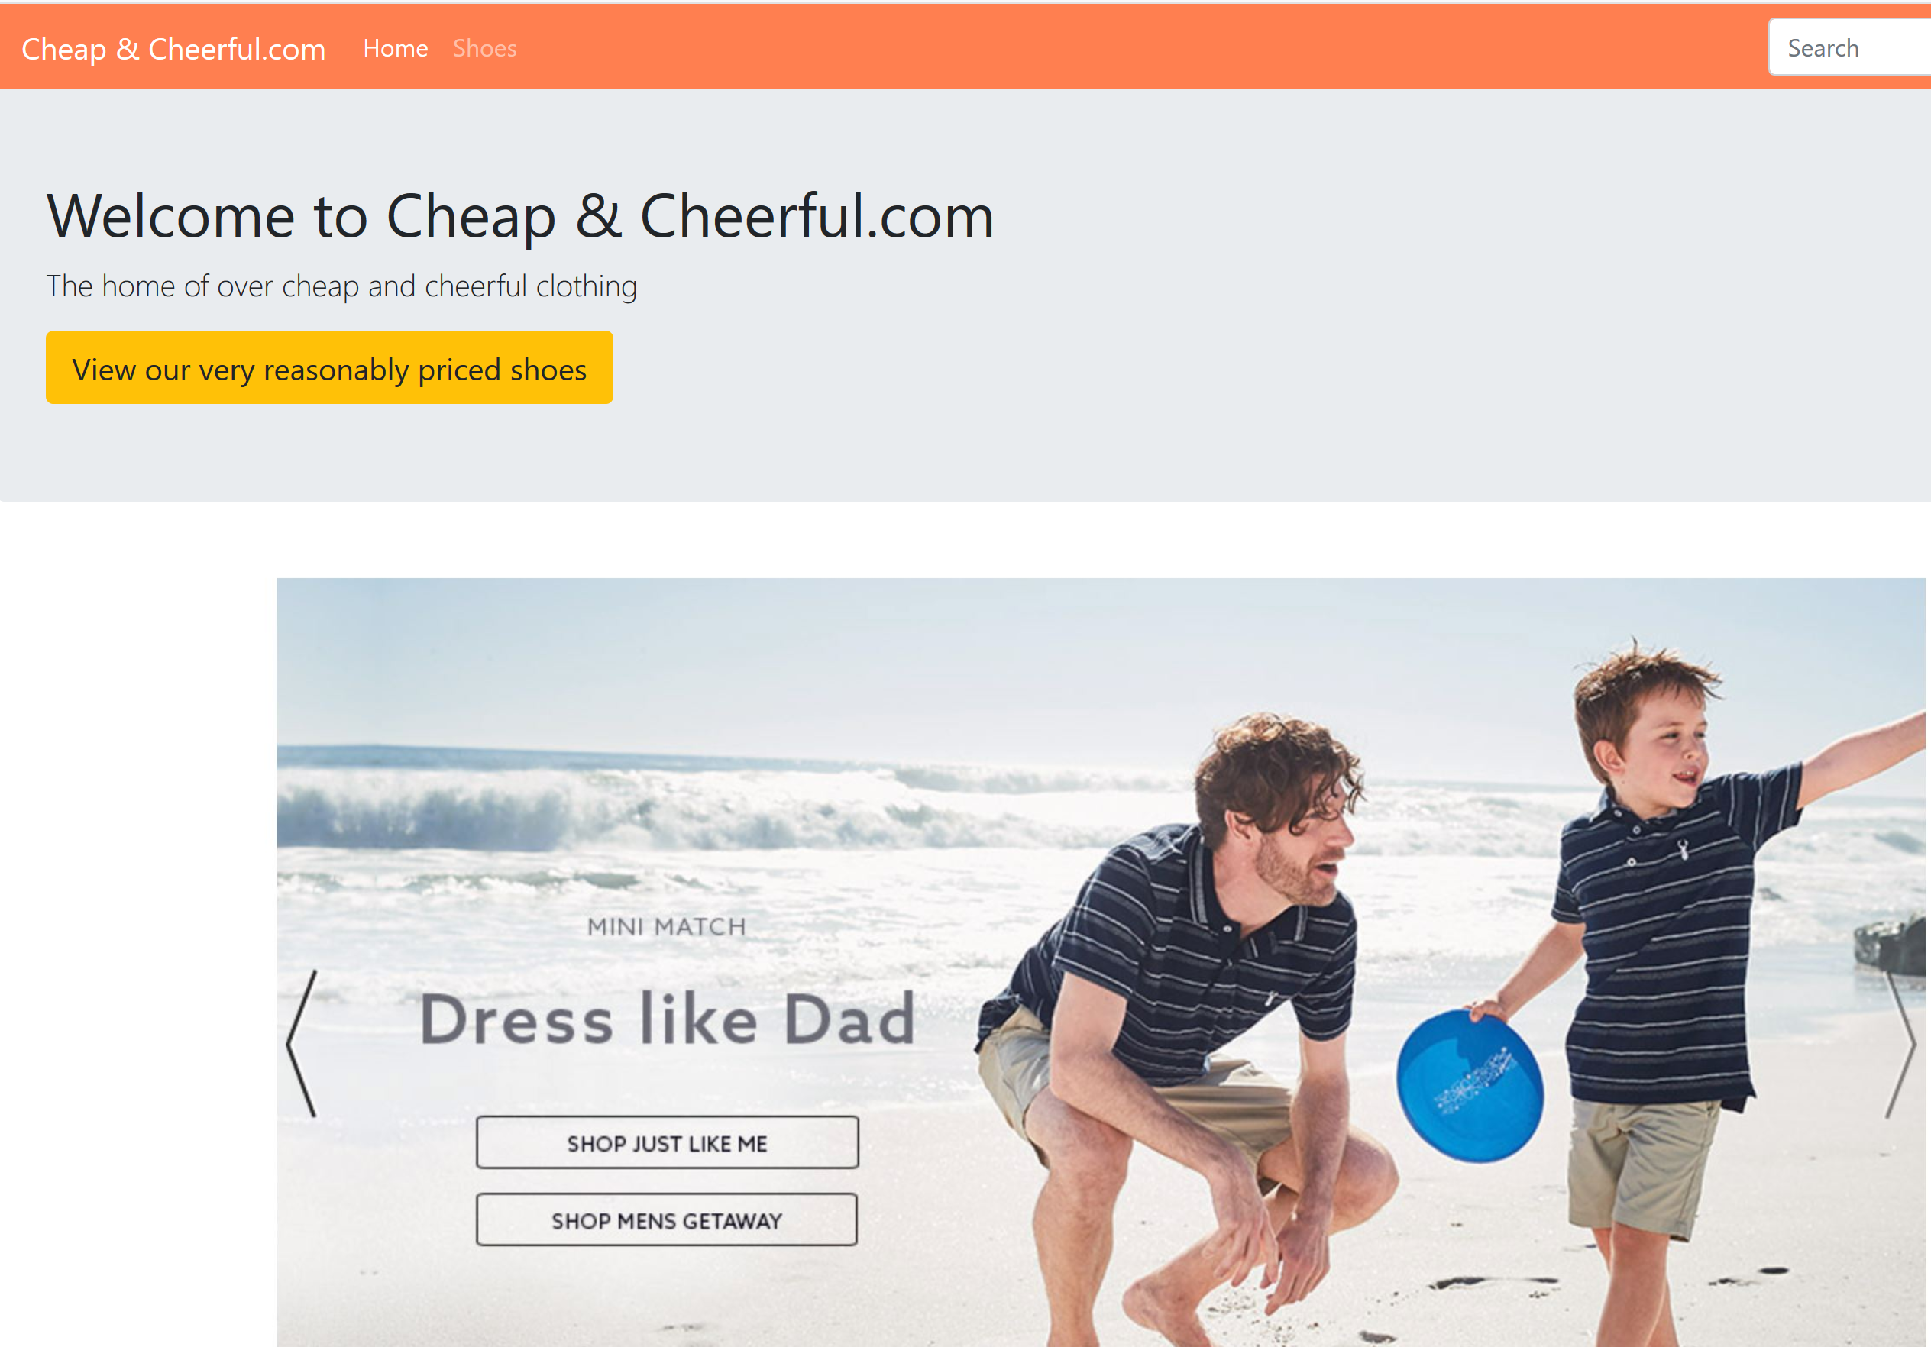
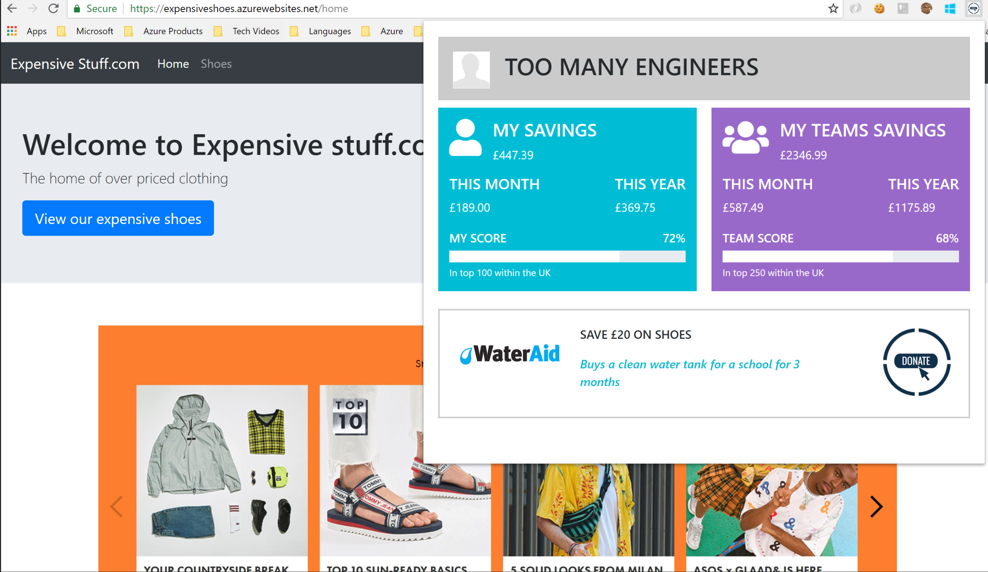
What does it look like - now?

Slide 5
How this address the asks of the hack?
Make Something: Does the project make or create something tangible that can be shown or demonstrated, going beyond an idea?
Yes
Address the Challenge: Does the project address the Challenge, and present a clear and relevant solution?
YES
Potential Value: Does the project align to business, cultural, career, or personal value?
Helps charities and makes it simple for people to donate and track donations
Feasibility: Does the project have actionable next steps and a reasonable chance of success in its implementation?
YES
AI and Ethics: Does the project adhere to the Microsoft principles for AI Technology and Designing AI for People?
AI does the compare – PricE API used
Inclusion: Does the project consider and include some of the many dimensions/facets of diversity in our world?
Yes
Keep it Simple: Does your project outcome deliver a simple, easy to understand experience for your target audience?
Yes

Slide 6
DEMO

Slide 7
Thank you from 2 many enginners

